Slide 1
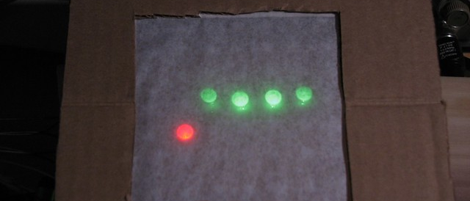
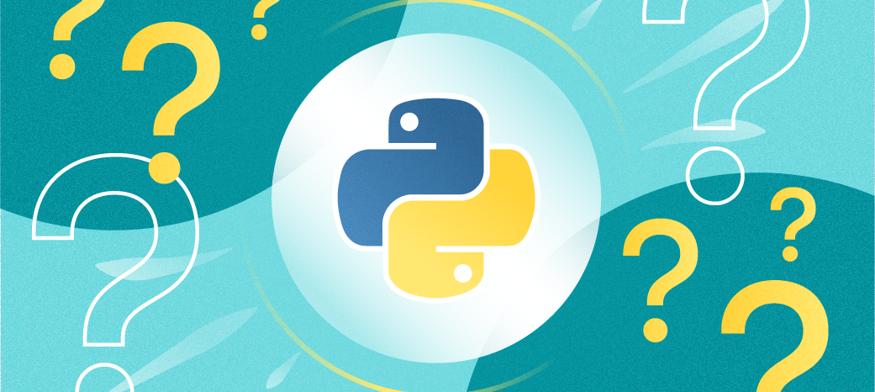
Snake Game
"Slither into excitement with Python's rendition of the timeless Snake game - where every move counts towards high scores and endless entertainment!"
By: Yara Dabdoub
https://github.com/ksu-is/Game-of-Snake--Yara-Dabdoub

